Slide 1


Blocks of tightly coupled DNA methylation in human stem cells and cancers.
Kun Zhang
Department of Bioengineering
University of California, San Diego

Slide 2

Disclosure of financial interest
Kun Zhang is a co-founder and scientific advisor of Singlera Genomics Inc. (La Jolla, CA)

Slide 3
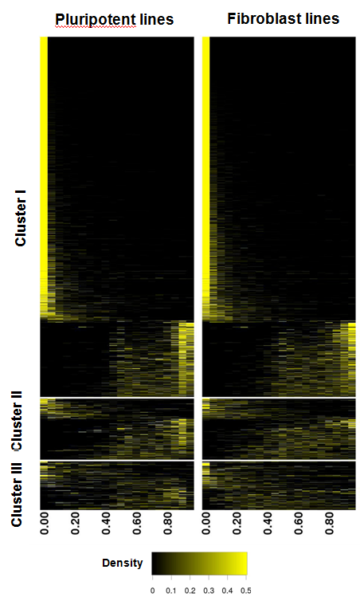
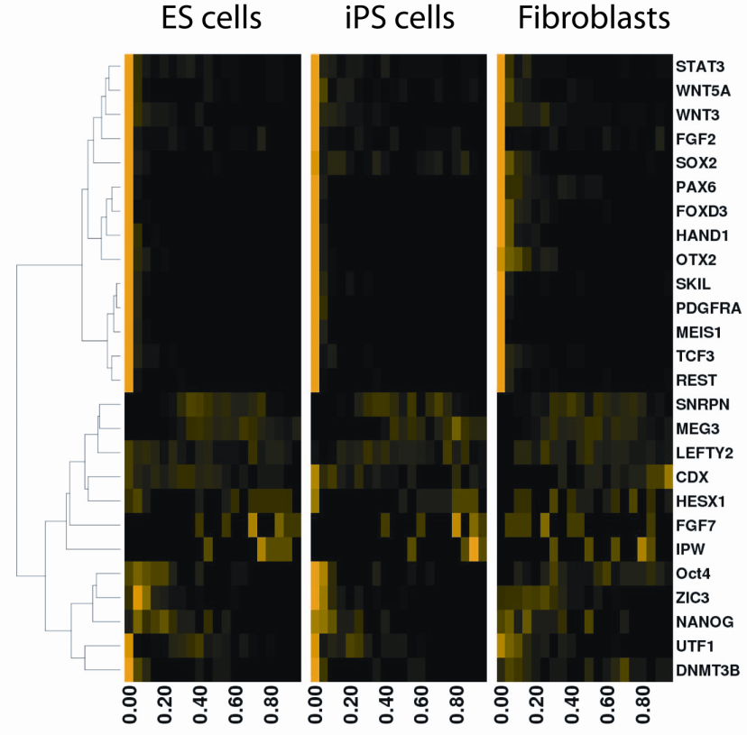
mC heterogeneity
26 genes, TSS
2,020 CGIs on chr 12/20
Deng et al. Nature Biotechnology, 2009

Slide 4
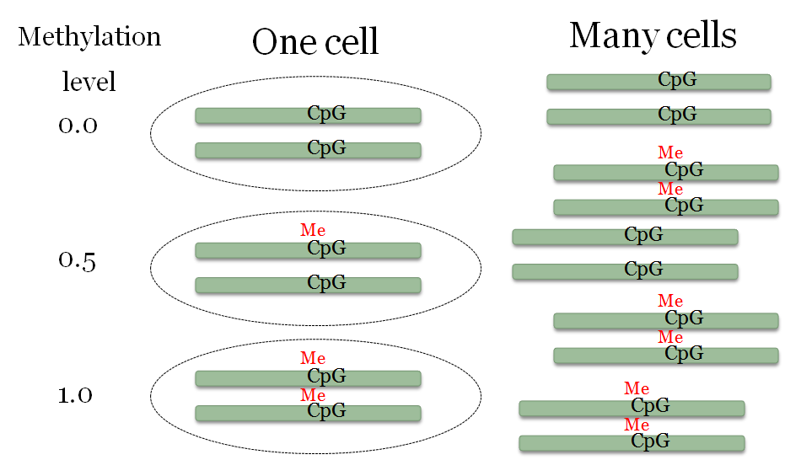
Single cell vs. cell population

Slide 5
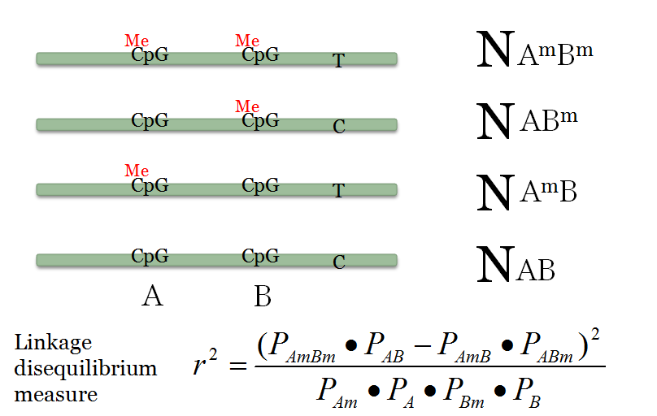
Methylation haplotypes
Shoemaker, Deng, et al. Genome Research, 2010

Slide 6
Expected methylation LD level
 | r2 between CpG | r2 with SNP
Heterogeneous cell population | High (~1) | Low (~0)
Genomic imprinting, X-inactivation | High (~1) | High (~1)
Intrinsic noise | Low (~0) | Low (~0)
Allele-specific genetic regulation | [0-1] | High (~1)

Slide 7
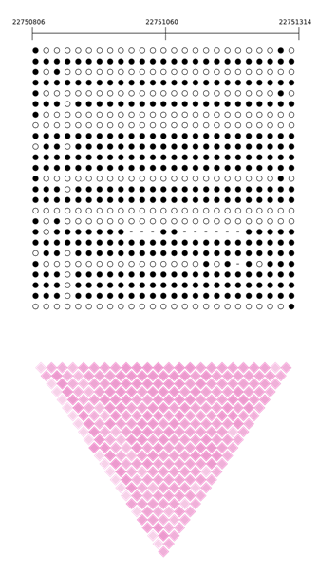
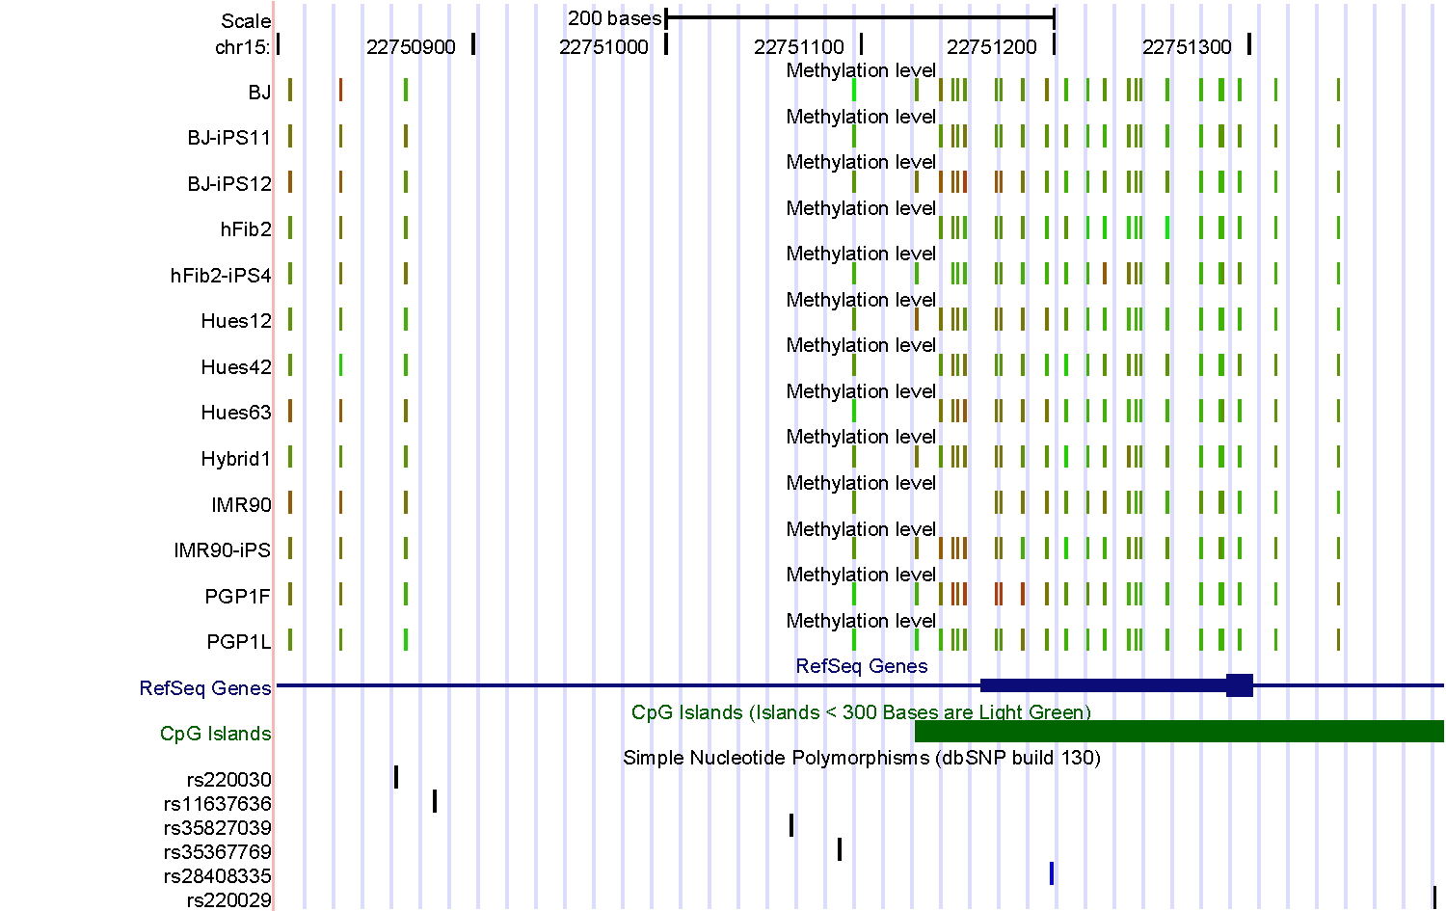
SNRPN (an imprinted gene)
HUES63
r² color key
0
.5
1
Shoemaker, Deng, et al. Genome Research, 2010

Slide 8
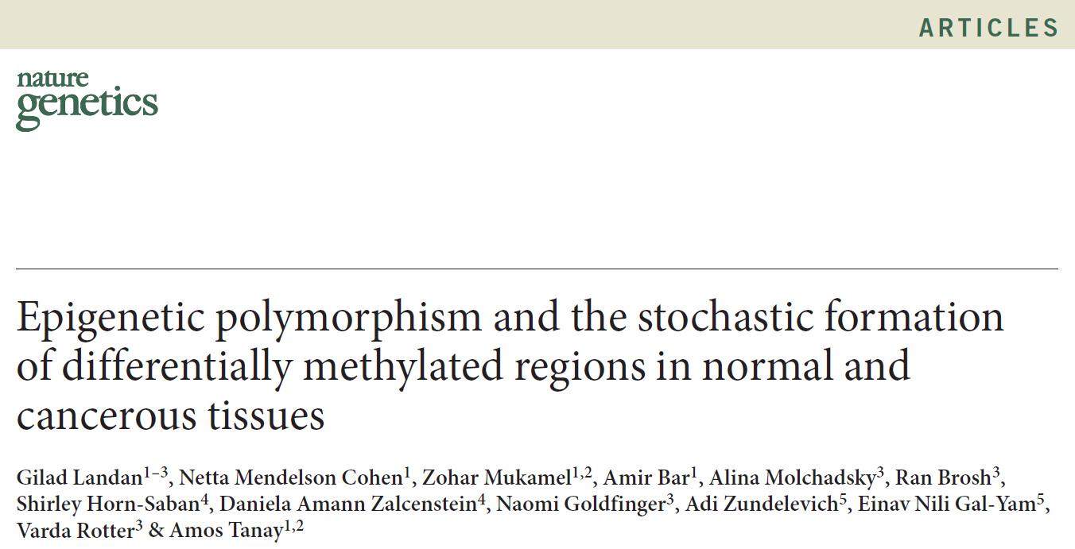
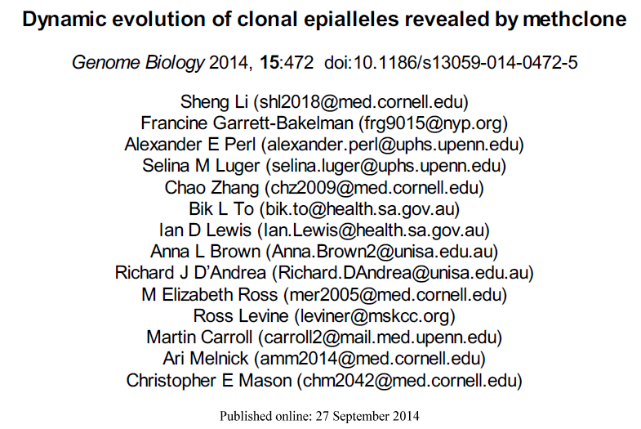
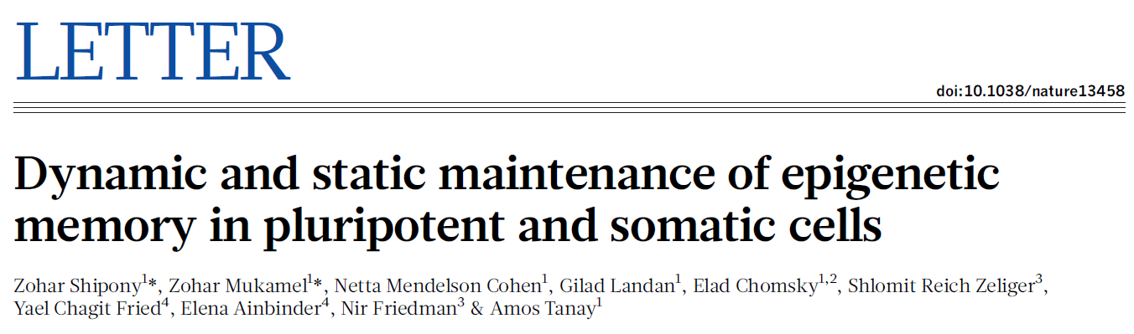
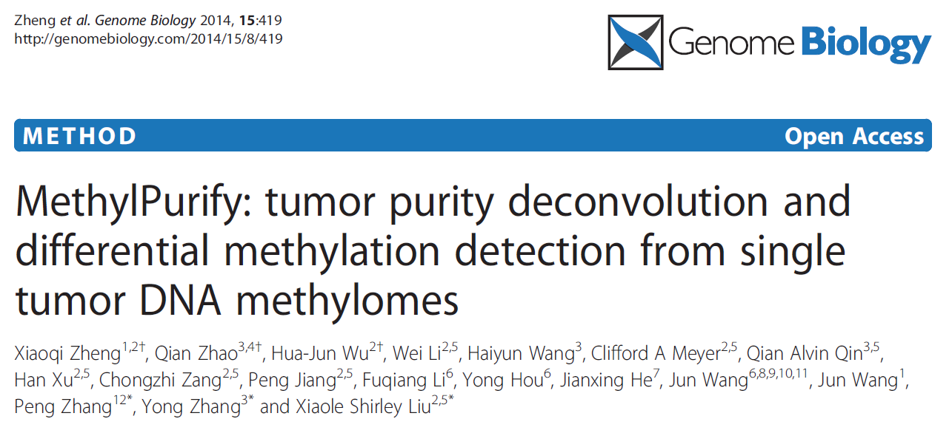
Epi-haplotypes

Slide 9
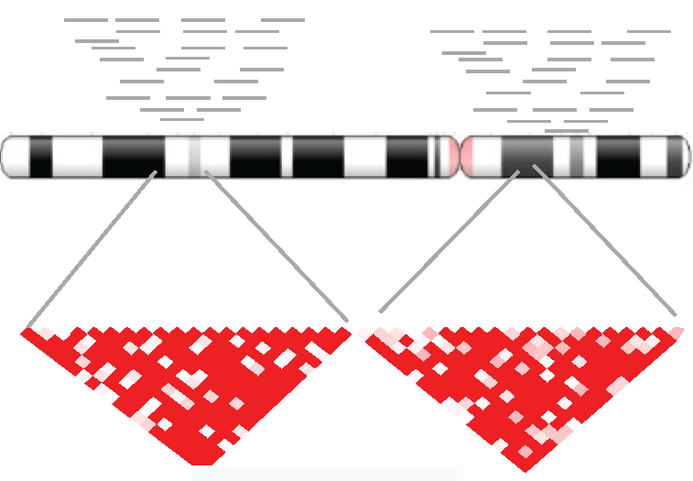
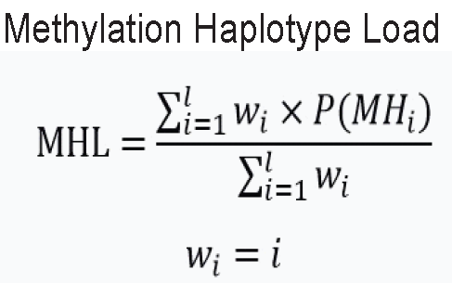
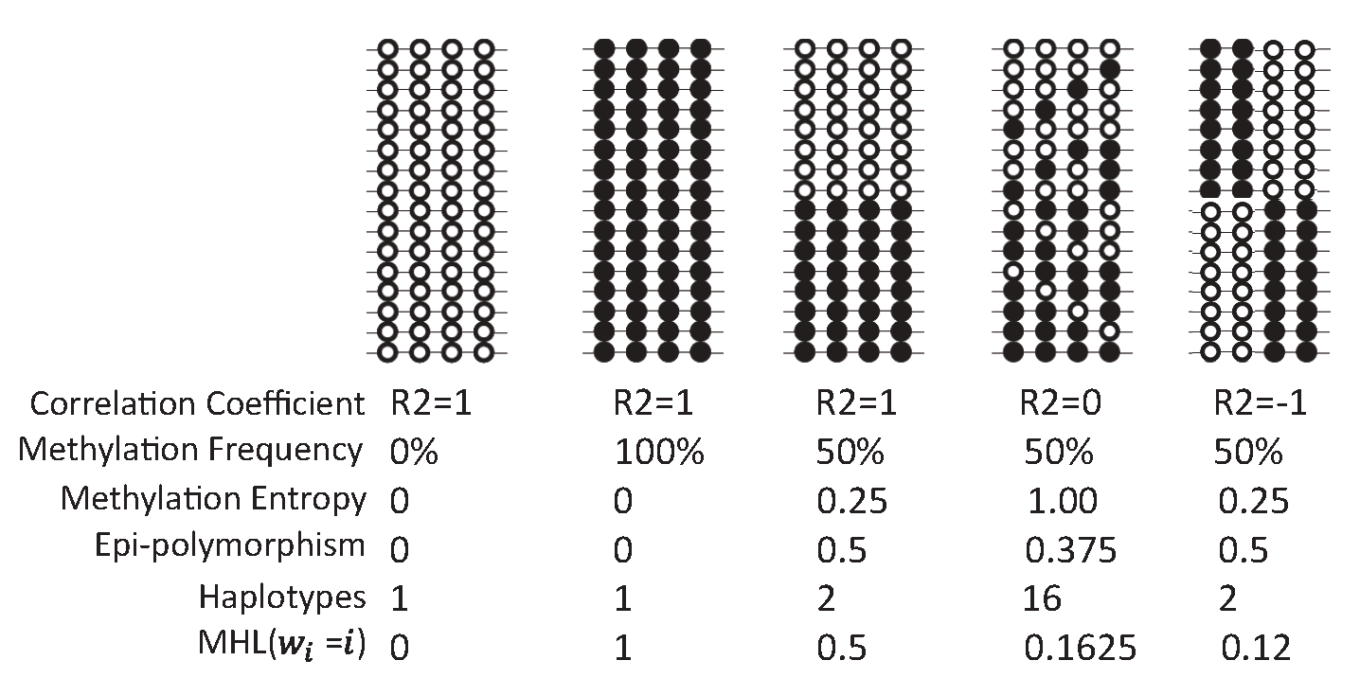
MHB & MHL
Methylation Haplotype Blocks (MHBs)

Slide 10
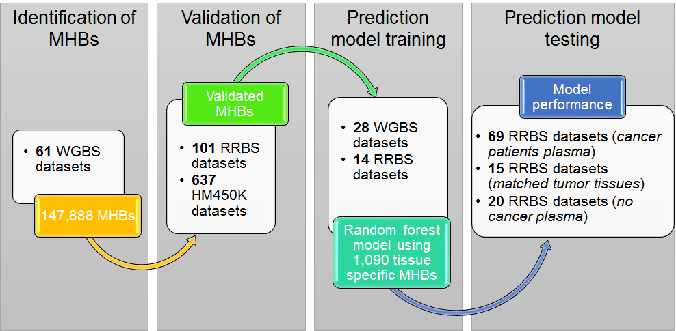
Genome-wide analysis

Slide 11
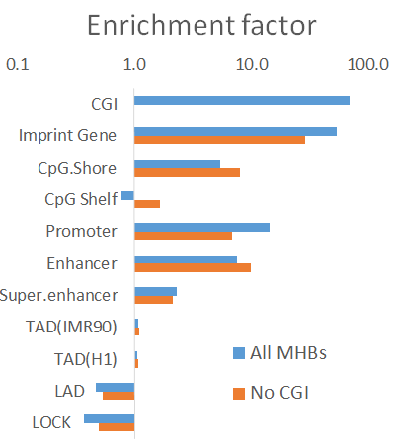
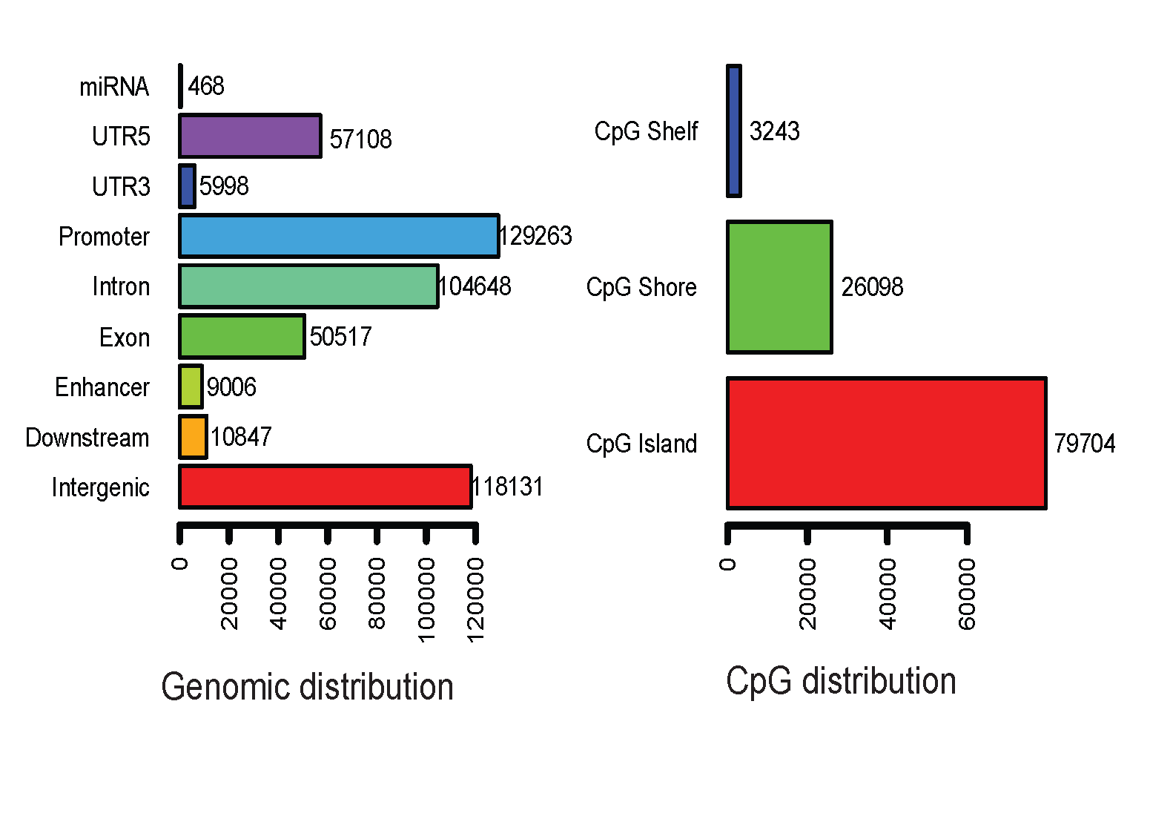
MHBs vs known genomic features
H3K27ac & H3K4me3

Slide 12
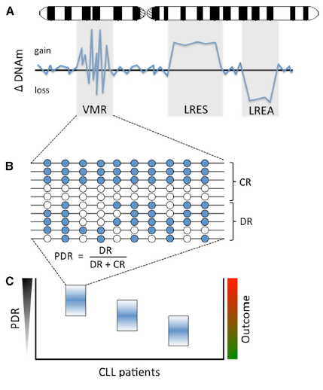
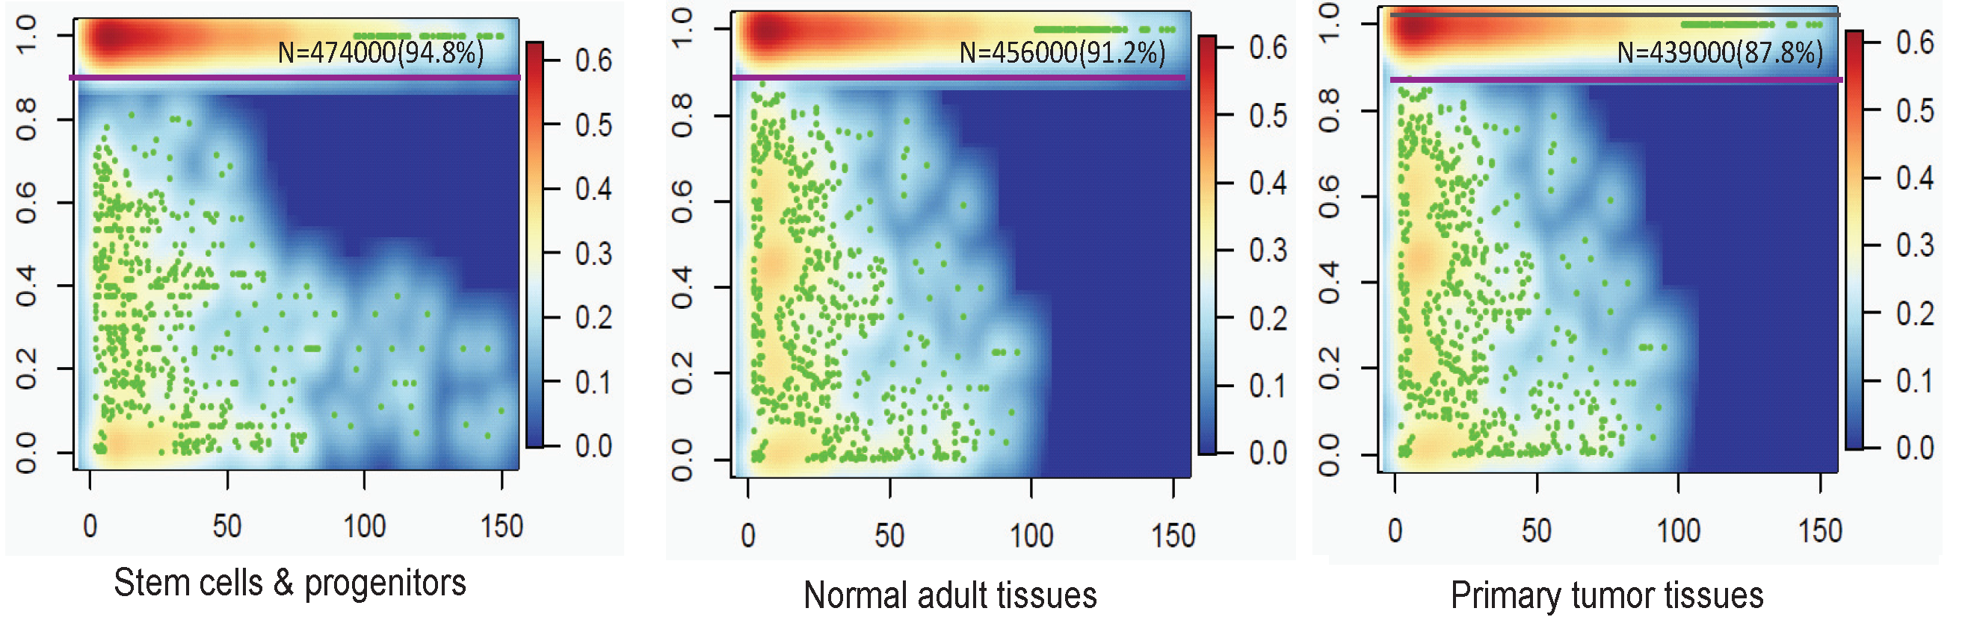
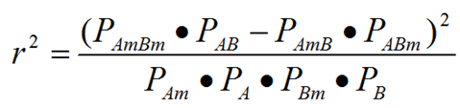
Degree of co-methylation
147,888 MHBs
Landau et al Cancer Cell, 2014
Swanton & Beck, 2014

Slide 13
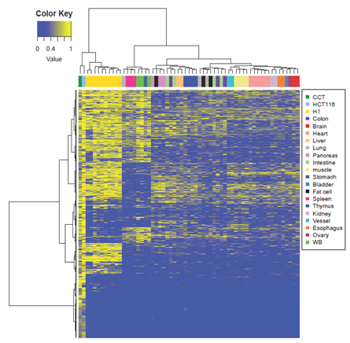
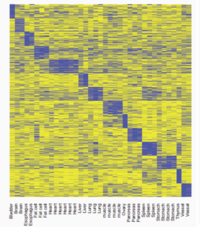
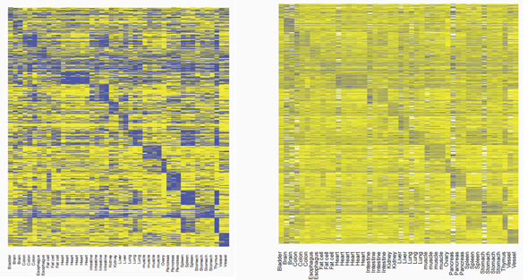
Classification with MHL
MHL
Average mC
mC

Slide 14
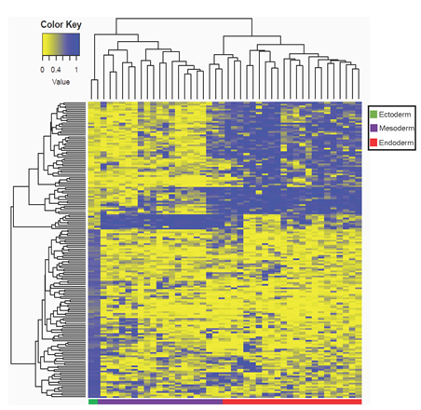
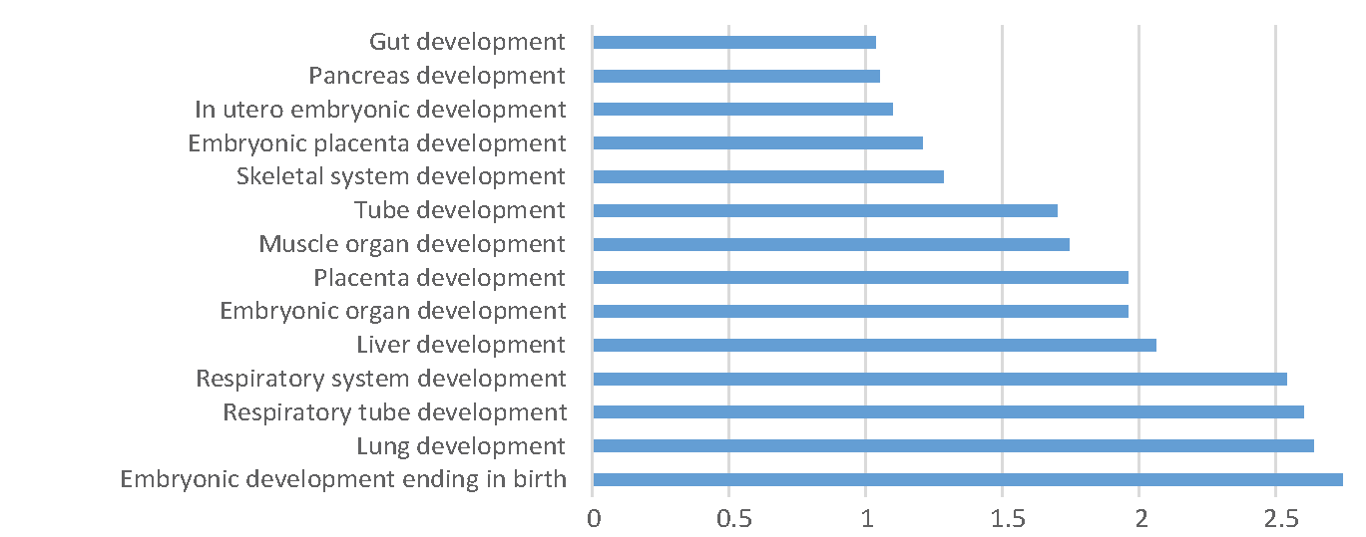
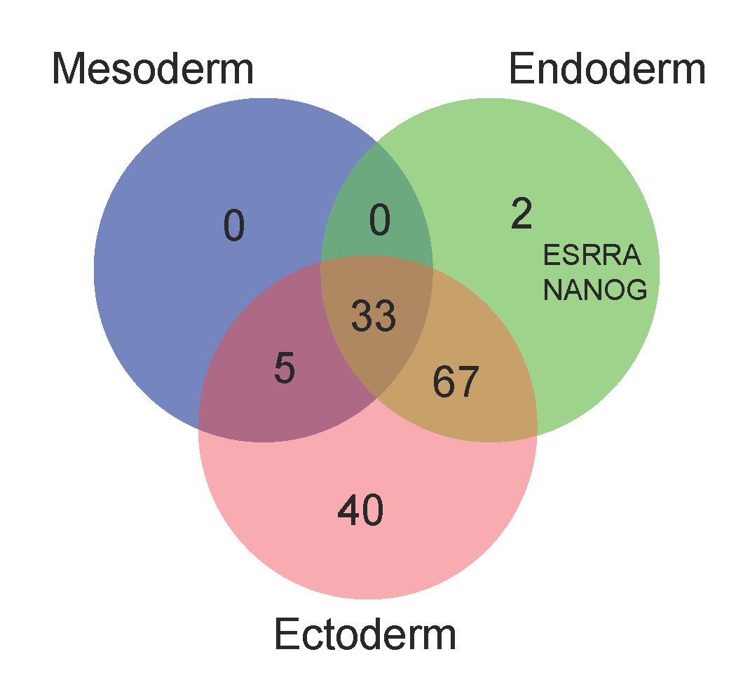
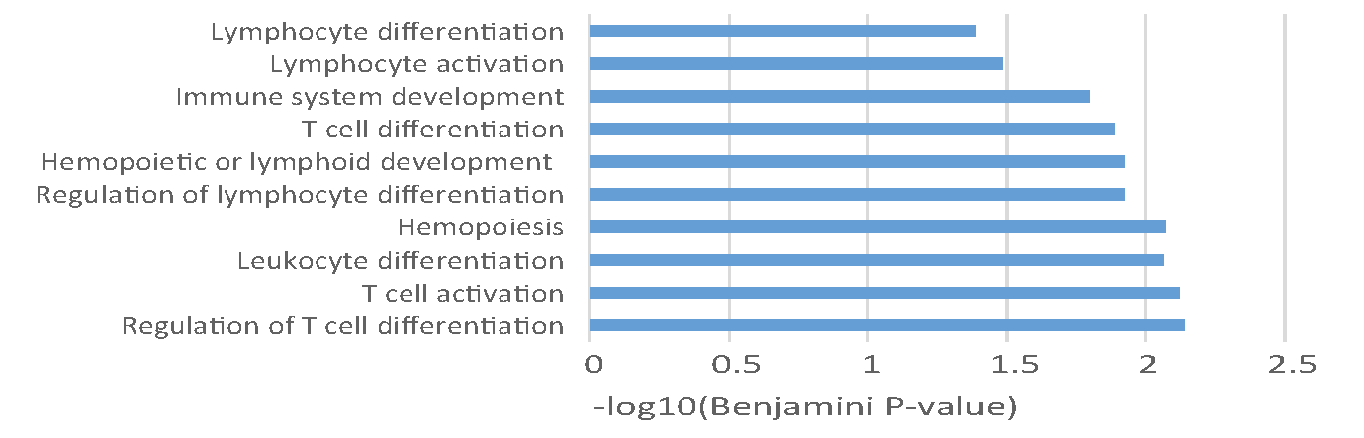
MHB: developmental germ layers
Low MHL in Meso- & Endoderm
38
102
High MHL Ectoderm
145

Slide 15
Fishing methylation haplotypes
90-99.99%
0.01~10%
Blood cells
Plasma
Placenta/tumor
Tumor haplotypes

Slide 16
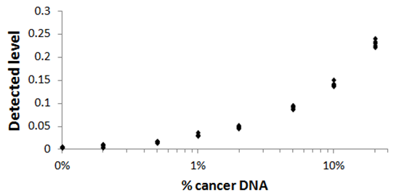
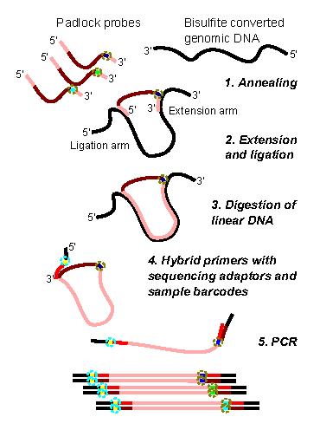
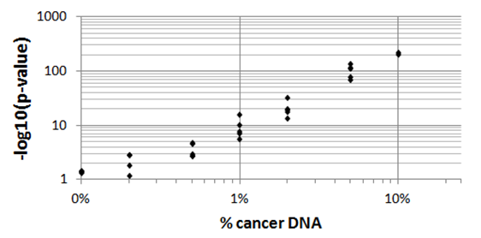
Proof-of-concept I
Sensitivity
Mixed DNA from cancer cell lines with whole blood
Confidence

Slide 17
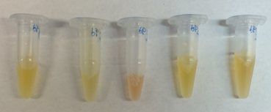
Samples from cancer patients
UCSD MCC Biorepository
Colon cancer: 30 plasma, 5 with matched primary tumors;
Lung cancer: 30 plasma, 5 with matched primary tumors;
Pancreatic cancer: 10 plasma, 5 with matched primary tumors;
30 plasma from non-cancerous individuals
Biochain:
1 colon cancer primary tumor tissue
Low-input RRBS (~1ng of plasma DNA)

Slide 18
Two questions:
Can we detect signatures of cancer from plasma?
Can we determine the tissue of origin?
Approach: random forest based feature selection and prediction.

Slide 19
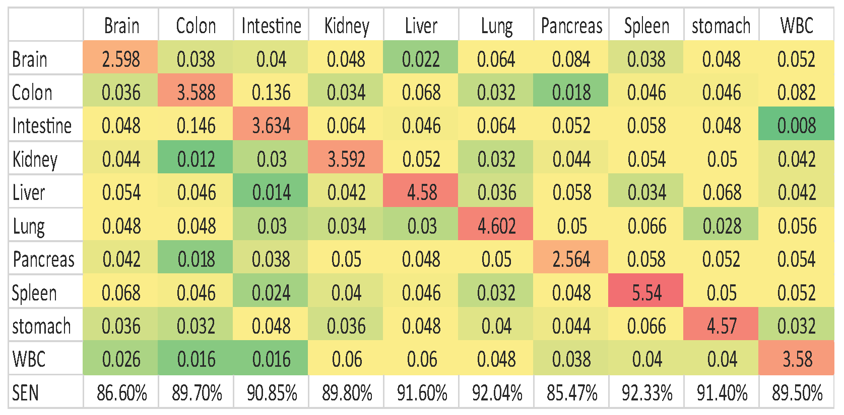
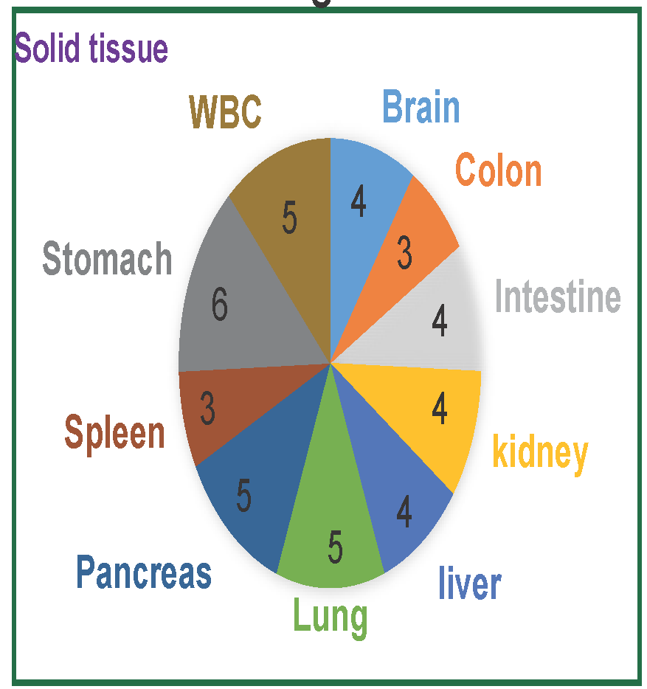
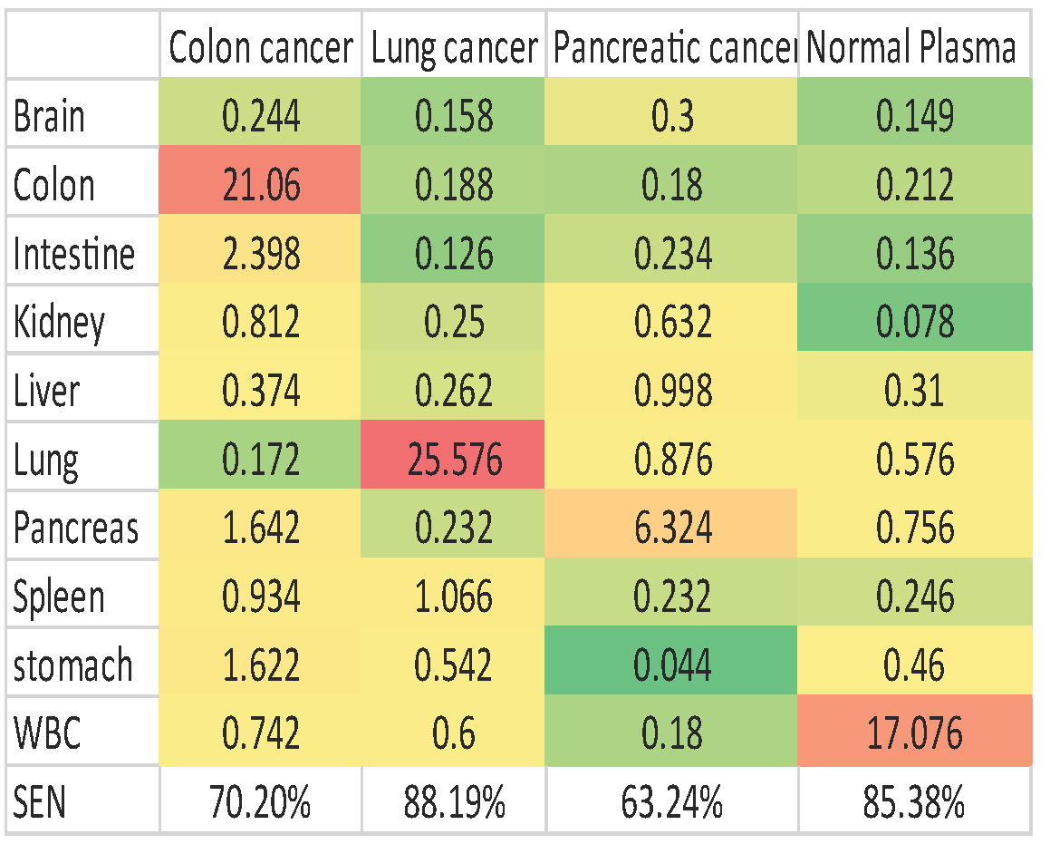
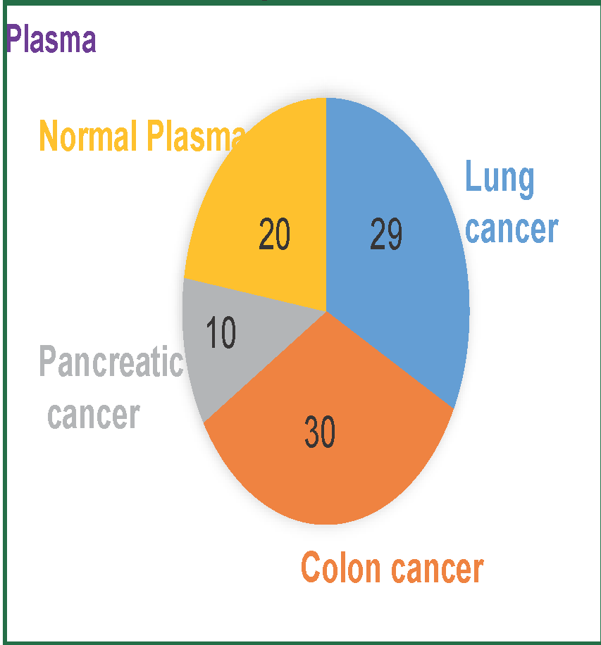
Tissue of origin
Training data set (WGBS)
Test data set (RRBS)

Slide 20
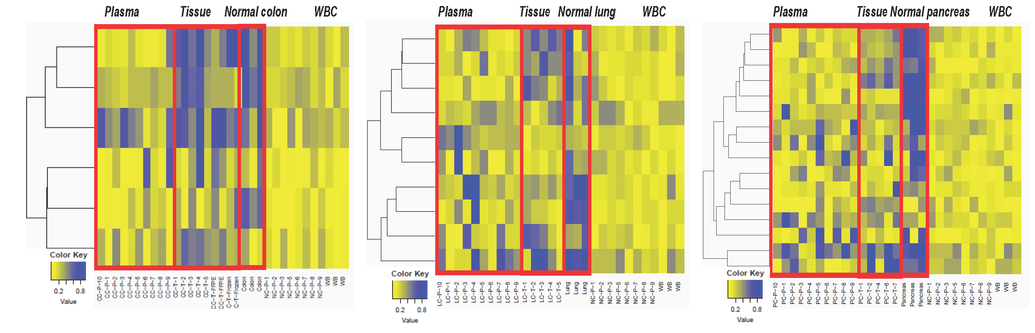
Tumor-specific MHL

Slide 21
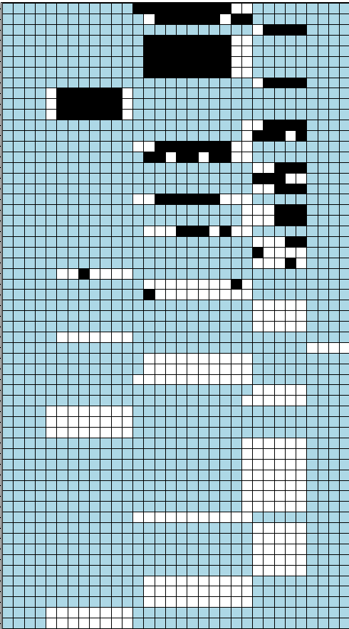

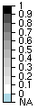
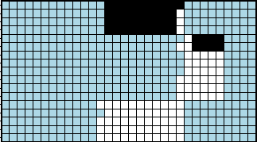
ESR1 tumor haplotypes detected
Tumor
Normal plasma
Matched plasma
N=17
N=46
N=59

Slide 22
Summary
Methylation of adjacent CpG sites on single DNA molecules is tightly coupled in >= 1% of the genome.
Methylation haplotype blocks represent a distinctive epigenomic feature.
Methylation haplotypes allow dissecting heterogeneity and detecting tumor signatures in plasma.

Slide 23
Acknowledgement
UCSD BE
Shicheng Guo
Dinh Diep
Nongluk Plongthongkum
Alan Fung
Athurva Gore
Jie Deng
Robert Shoemaker
UCSD SOM
Kang Zhang
UCSD MCC Biorepository
Sharmeela Kaushal
Funding:
NIDA R01 (Epigenomics Roadmap Tech. Dev.)
NIGMS R01

